Slide 1
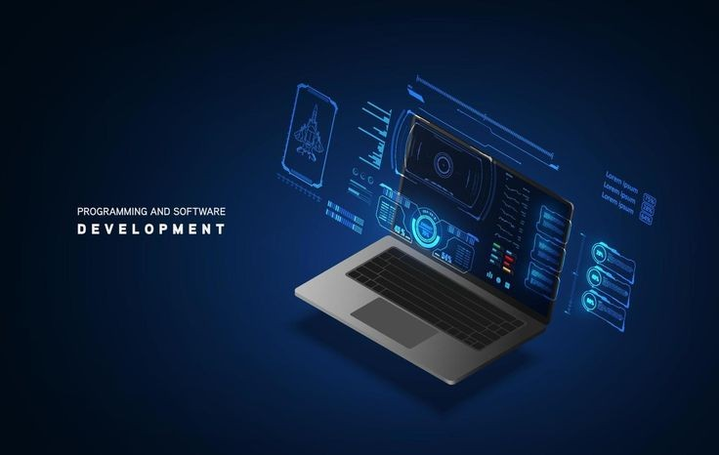
Assignment
Prepared by: Amr Shamis
Under the supervision of Engineer: Malik Al-Musannaf

Slide 2



Slide 3


Slide 4


Slide 5
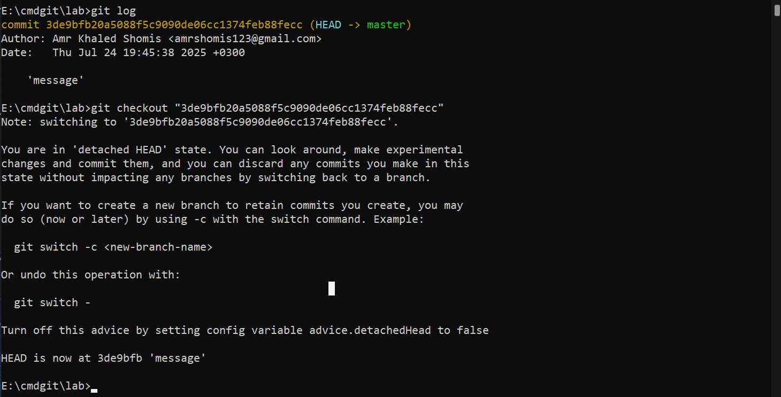

Slide 6


Slide 7


Slide 9


Slide 11


Slide 12


Slide 13


Slide 14


